Slide 1

GRAPHS REPRESENTATION AND TRAVERSAL

Slide 2
GRAPH COMPONENTS
Nodes
Edges
1
2
3

Slide 3
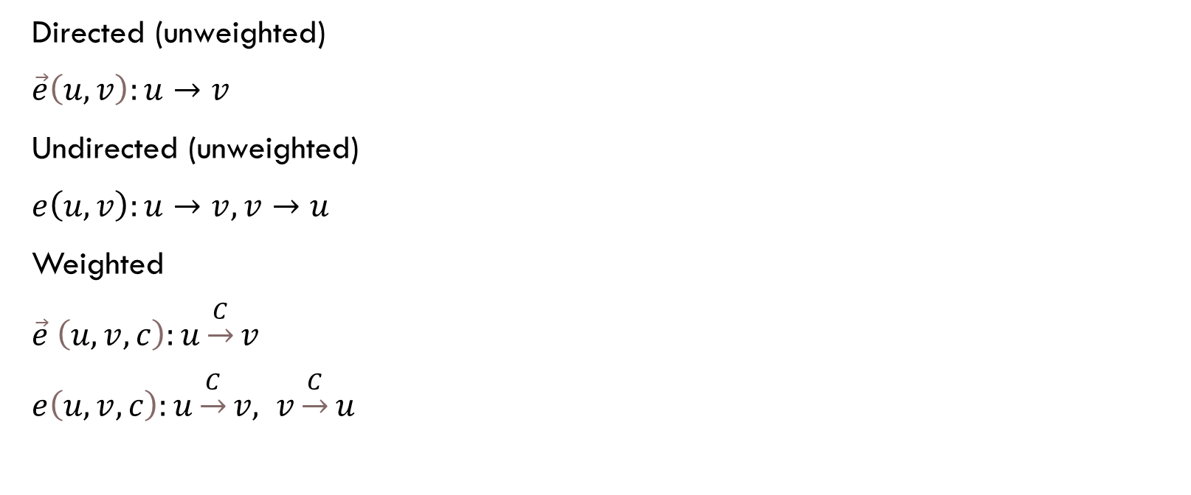
TYPES OF EDGES

Slide 4
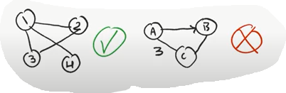
COMPONENTS MUST REMAIN CONSISTENT
All edges on a graph must be of the same type
The same principle is also applied to the weights (either all edges have weights,
or none have)

Slide 5
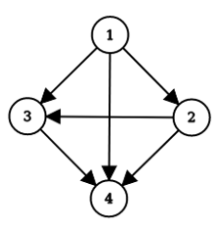
GRAPH TERMINOLOGY
In Degree: The number of edges that goes into the node
Out Degree: The number of edges that comes out of the node
- For each node in an undirected graph in-degree = out-degree
- In any graph:
∑In-Degrees = ∑ Out-Degrees

Slide 6
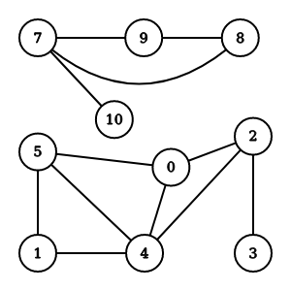
GRAPH TERMINOLOGY
Adjacency Relation: Nodes ‘a’ and ‘b’ are called adjacent (neighbours), iff (if and only if) there’s a direct edge between ‘a’ and ‘b’.
Nodes 7-9 are called neighbours.
Nodes 4-3 are NOT neighbours.
Nodes 0-10 are NOT neighbours.

Slide 7
GRAPH TERMINOLOGY
Multigraph: A graph that may have multiple edges between the same pair of nodes.
Self Loop: An edge that connects a node to itself.
Simple Graph: An undirected graph without multiple edges or self-loops.

Slide 8
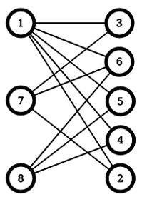
GRAPH TERMINOLOGY
Bipartite Graph: A graph that can be
partitioned into two sets such that
there’s no edges between nodes of
the same set (i.e. it can be bicolored).

Slide 9
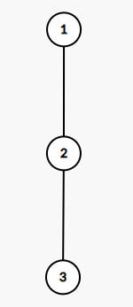
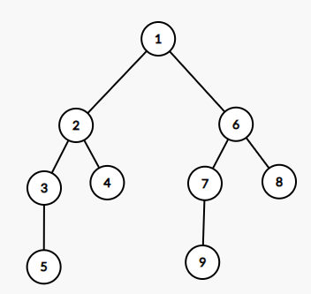
TREES
A tree is an undirected, connected, acyclic graph
Note: all trees with n nodes have n-1 edges, each node has only one parent

Slide 10
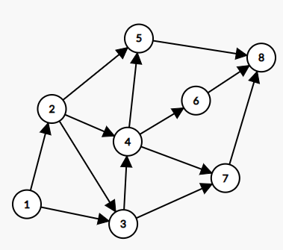
DAG (DIRECTED ACYCLIC GRAPH)
A directed graph with no cycles.
A great example of a DAG is the dependency tree of a program.

Slide 11
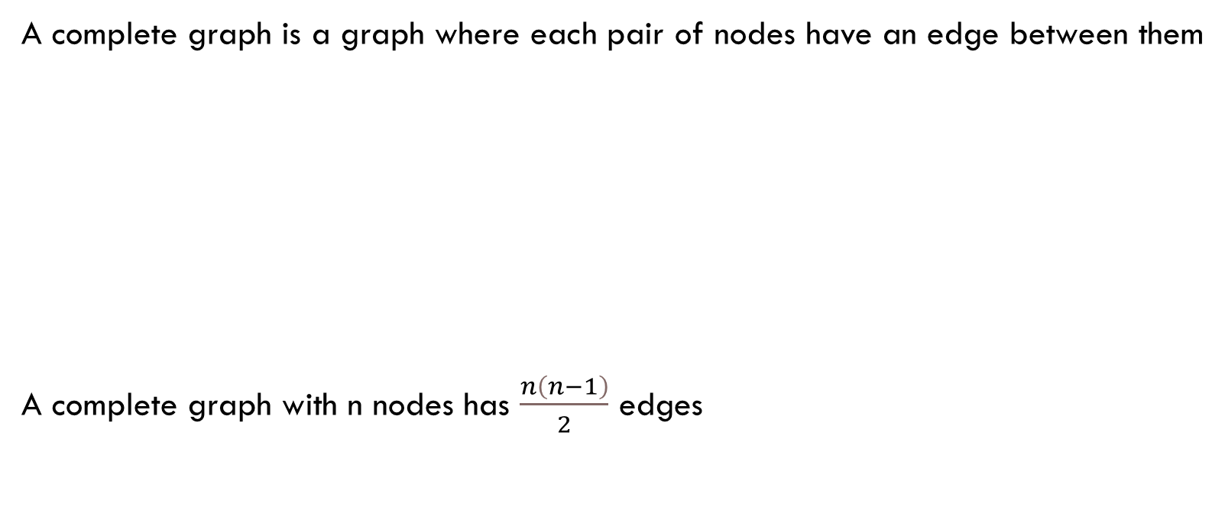
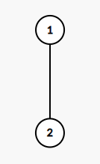
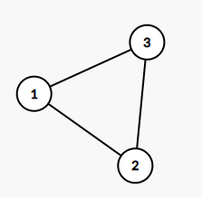
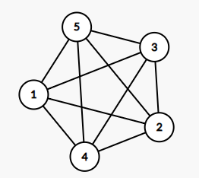
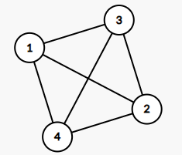
COMPLETE GRAPH

Slide 12
GRAPH REPRESENTATION
Adjacency Matrix
Adjacency List
Edge List

Slide 13
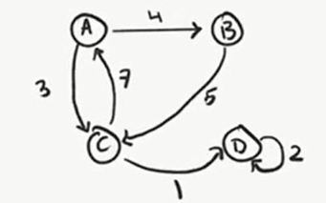
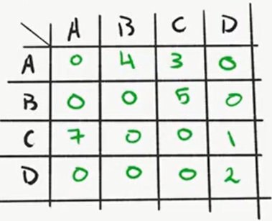
ADJACENCY MATRIX
Pros:
Space efficient for dense graphs
Edge lookup in O(1)
Cons:
O(V²) space
O(V²) to visit all edges

Slide 14
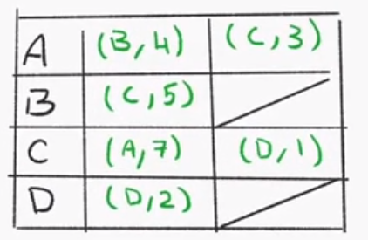
ADJACENCY LIST
Pros:
Space efficient for sparse graphs
Cons:
Edge lookup in of O(E)
Less space efficient than adj matrix for dense graphs

Slide 15
COMMON GRAPH PROBLEMS
Connectivity
Connected components
Shortest paths (next session)

Slide 16
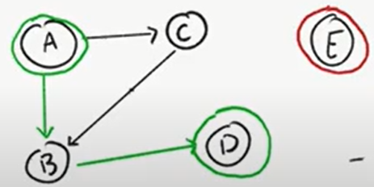
CONNECTIVITY
Is A connected to D?
Is A connected to E?

Slide 17
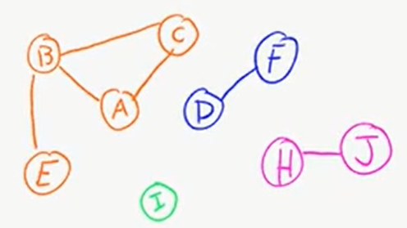
CONNECTED COMPONENTS
What are the connected components of this graph?

Slide 18
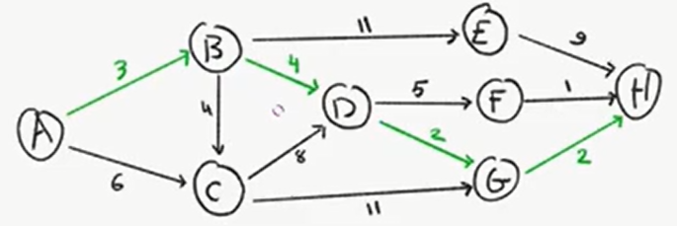
SHORTEST PATH
What is the shortest path from A to H?

Slide 19
GRAPH TRAVERSAL
In order to write programs to solve graph problems, we need a way to traverse (walk through) those graphs, graph traversal algorithms include:
DFS (Depth First Search)
BFS (Breadth First Search)

Slide 20
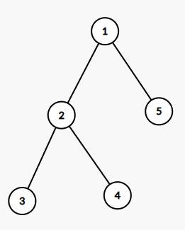
DFS (DEPTH FIRST SEARCH) CONCEPT
Follows a path as long as it can visit more nodes, backtracks upon reaching a dead end

Slide 21
DFS (DEPTH FIRST SEARCH) CODE
https://ideone.com/Jsnfxy

Slide 22
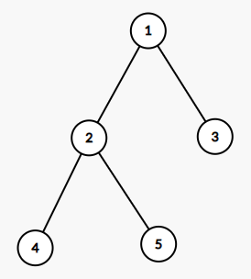
BFS (BREADTH FIRST SEARCH) CONCEPT
Visits the nodes in an increasing order of their distance from the starting node (in other words it traverses the graph level by level).

Slide 23
BFS (BREADTH FIRST SEARCH) CODE
https://ideone.com/60z7wt

Slide 24
PRACTICE
Problem1: https://codeforces.com/problemset/problem/35/C
Solution: https://ideone.com/rw9mHh
Problem2: https://www.spoj.com/problems/PT07Y/en/
Solution: https://ideone.com/7JdKGJ
Problem3: https://www.spoj.com/problems/BUGLIFE/en/
Solution: https://ideone.com/F0ssus

